Slide 1
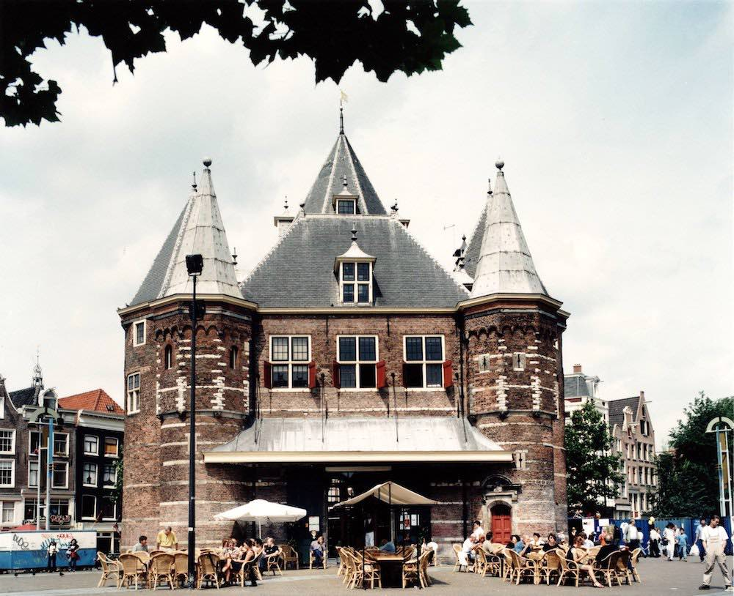


Internship
Laura Weller
AMFI 2023-2024

Slide 2
The company
General process
Intertwined activities
Future
Internship
Laura Weller
AMFI 2023-2024

Slide 3
The company
De Waag
Futurelab for technology and society
Interdisciplinary team of designers, artists and scientists, utilising public research methods in the realms of technology and society.
Open, honest and inclusive future.
Internship
Laura Weller
AMFI 2023-2024

Slide 4
The company
fablab
Fablab is a workplace that offers access to a number of computer-controlled prototyping machines, where users can convert their ideas into tangible products.
Interns can do their own projects
Internship
Laura Weller
AMFI 2023-2024

Slide 5
The company
Project
A phygital open-source biodegradable collection that can be worn during and supports an Extinction Rebellion blockade
Internship
Laura Weller
AMFI 2023-2024

Slide 6
General process
Goal 1
By the end of the month August, I would like to understand the way of working at De Waag. I want to understand the machines, the organizational culture and know my coworkers’ names and projects they are working on.
acclimatization phase
Research phase
Experimentation phase
Decision making phase
Understanding the company culture
Getting to know my colleagues
Understanding the machines
Understanding the way of working
Researching biomaterials
Researching Extinction Rebellion
Researching activism
Experimented with the biomaterials
Sizing,water resistance and compostable and strongness testing
Coloration of the materials
Sizing up to bigger scale
Internship
Laura Weller
AMFI 2023-2024

Slide 7
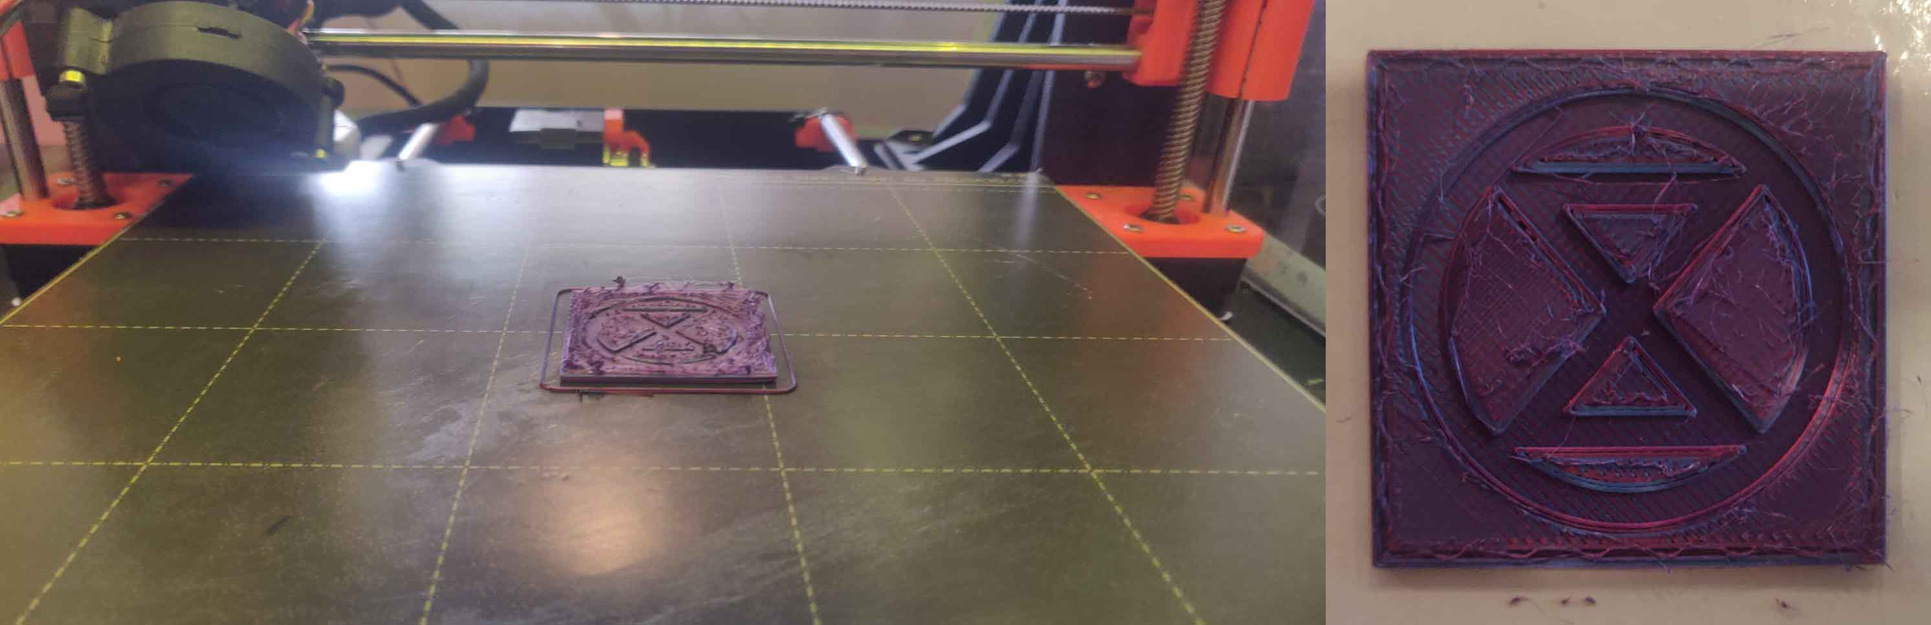
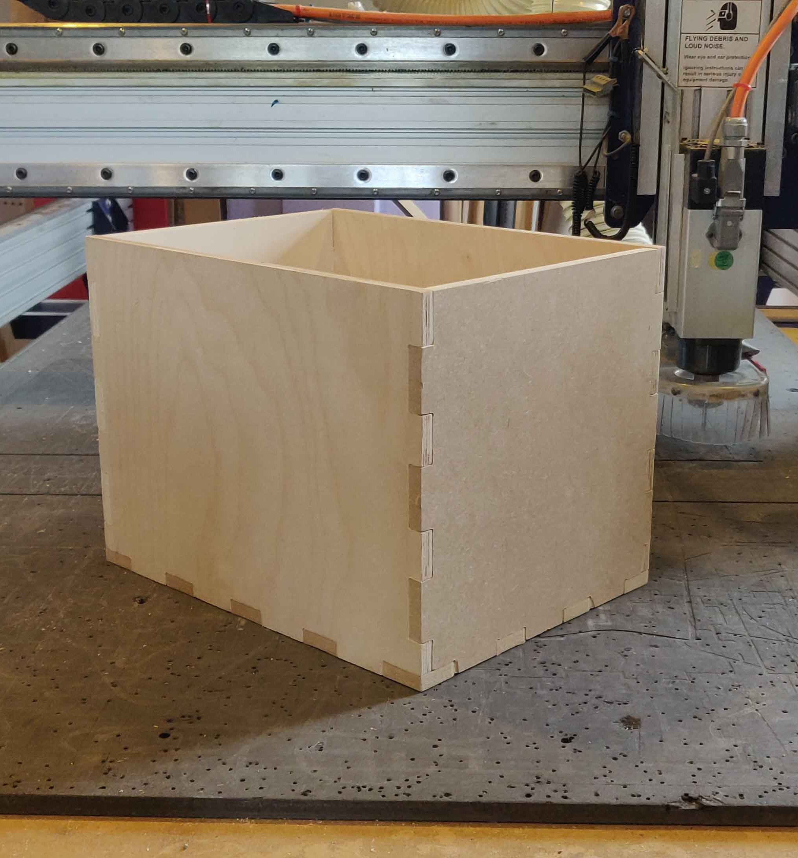
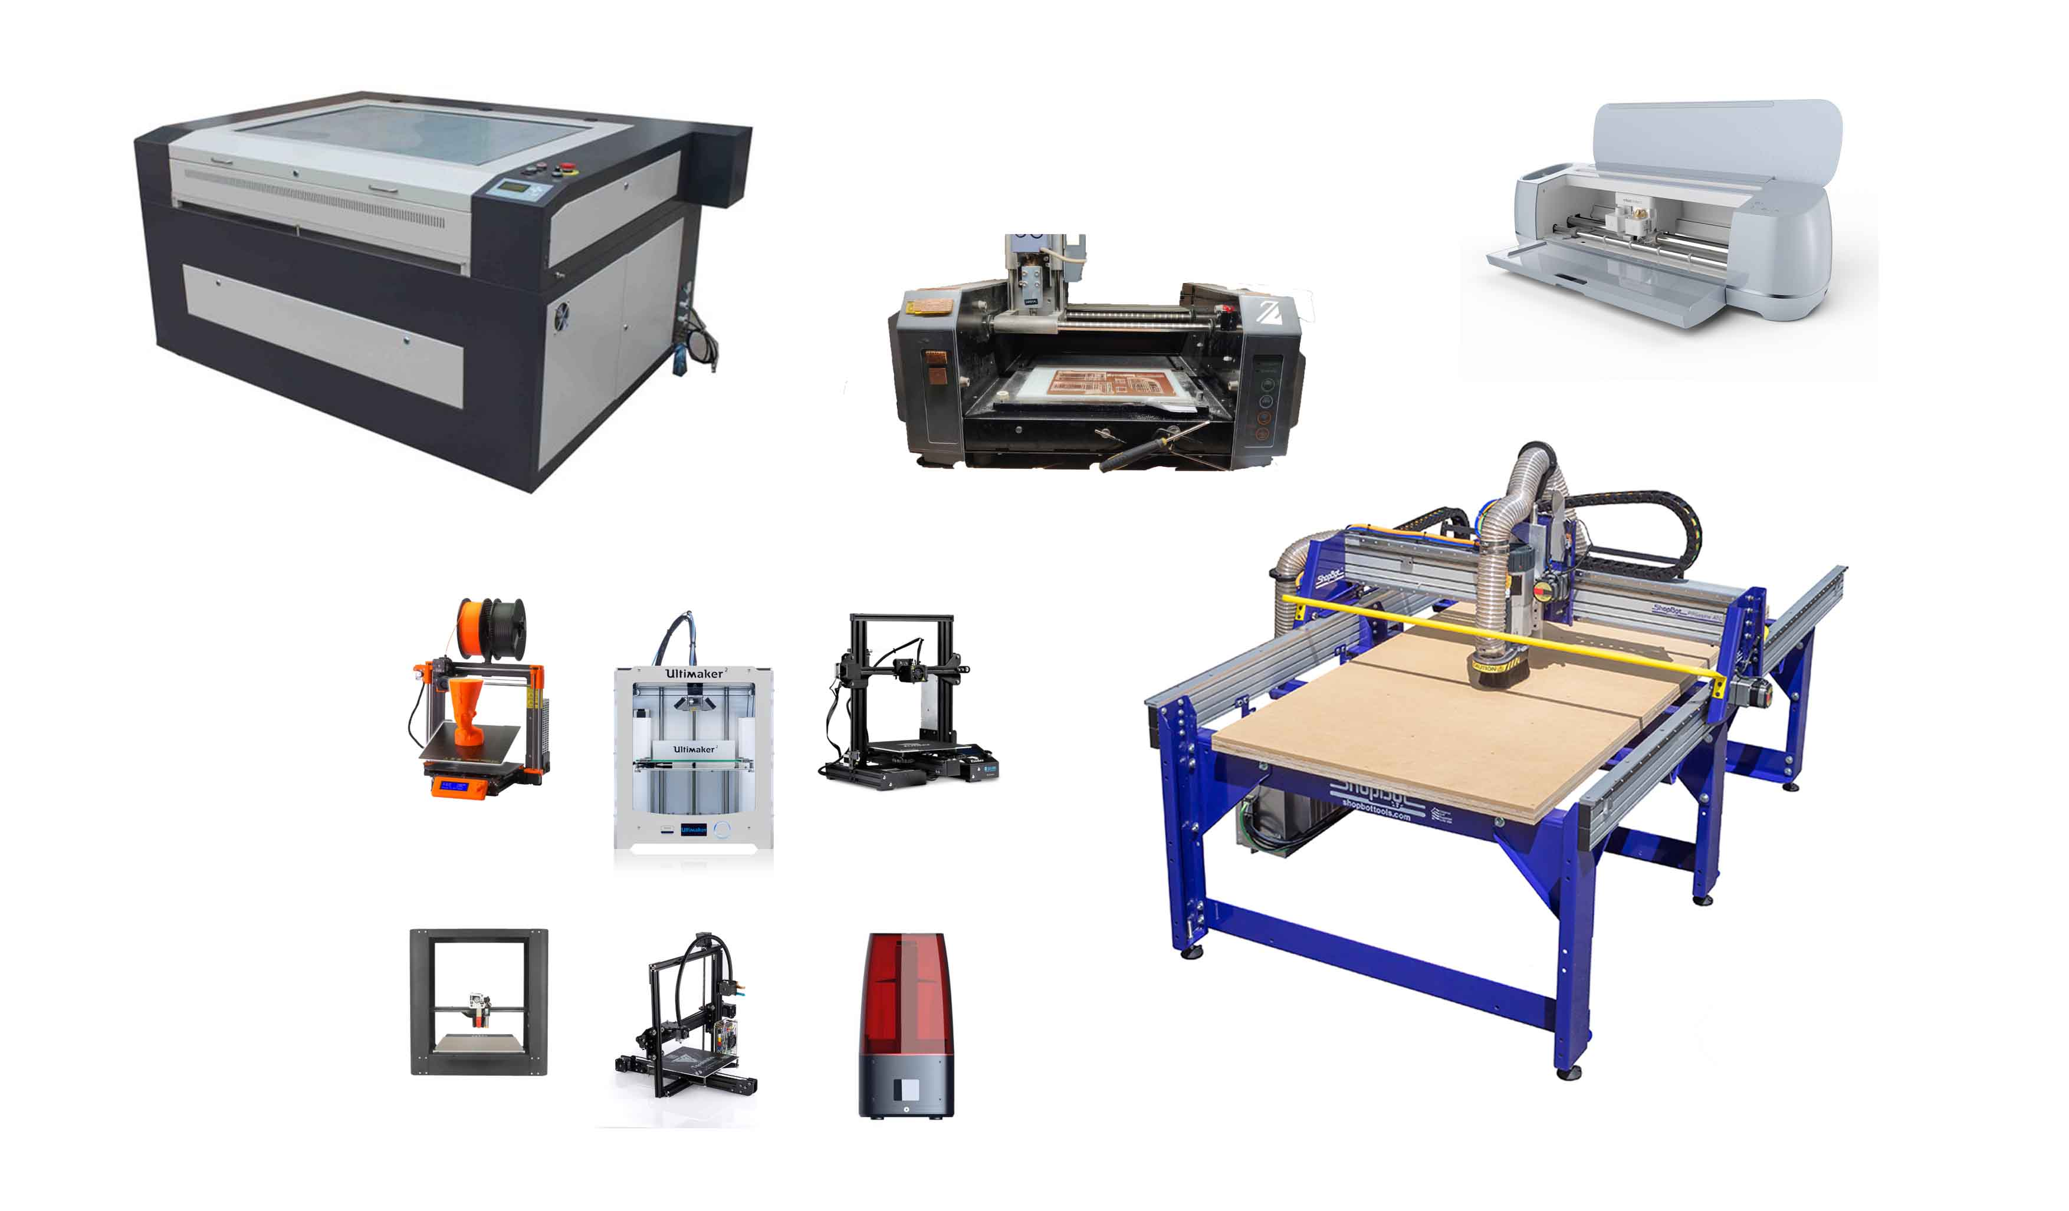
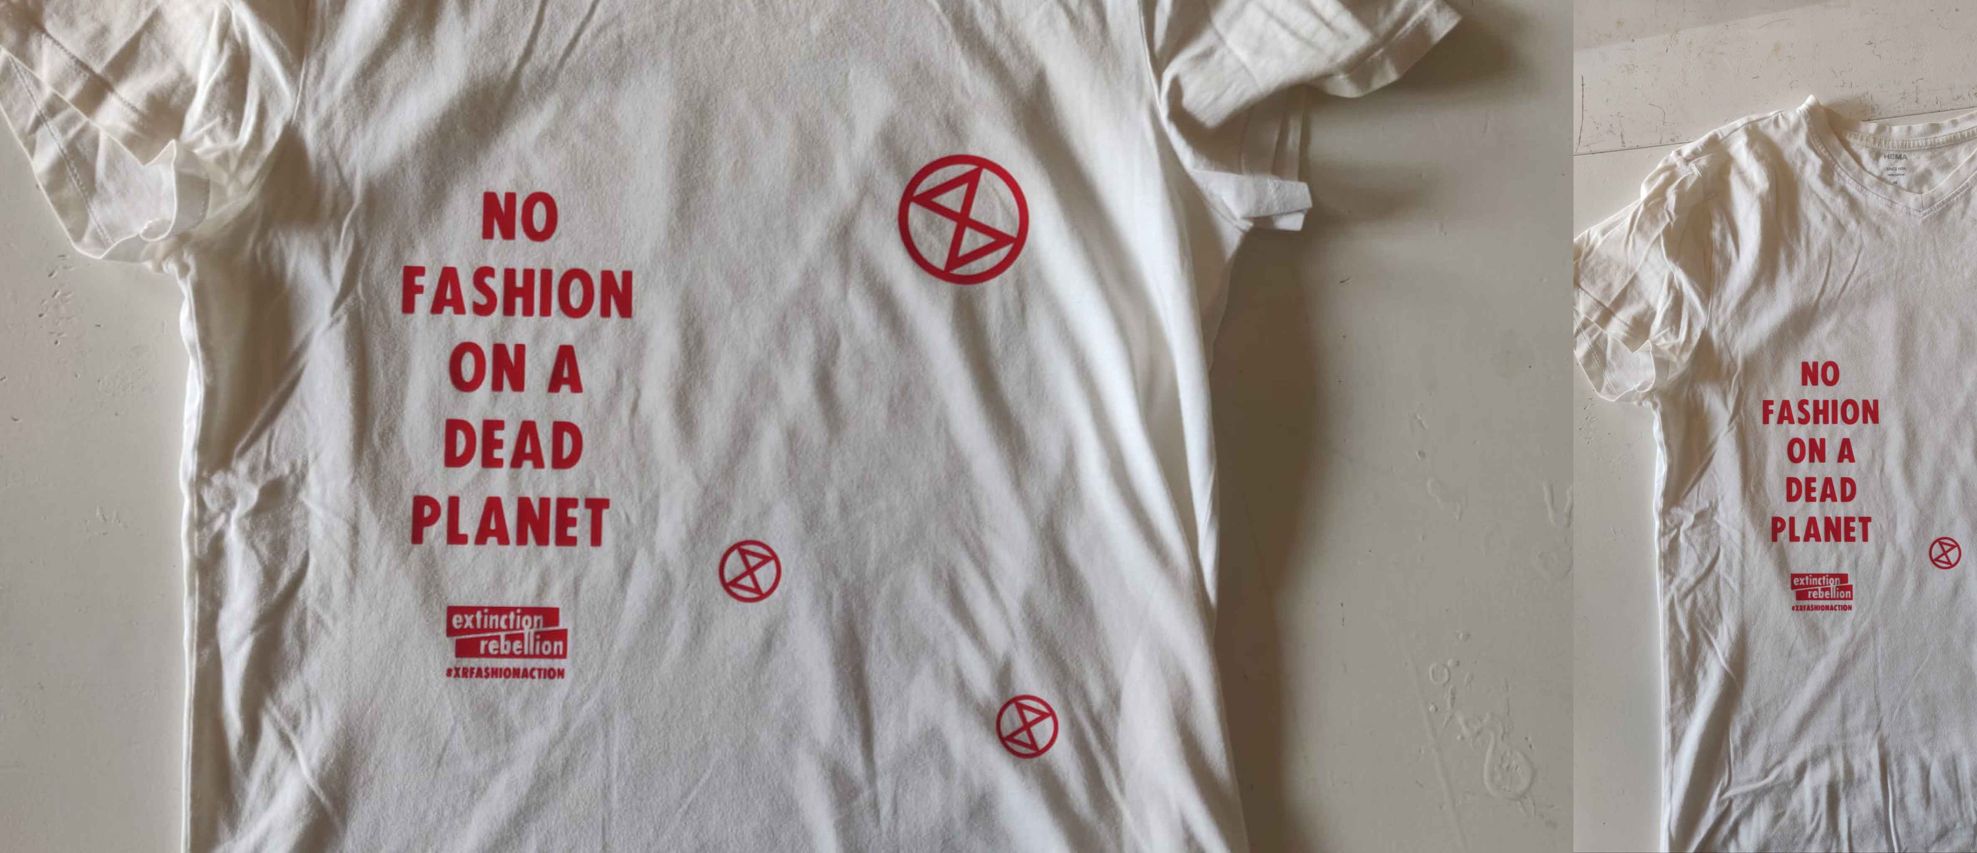
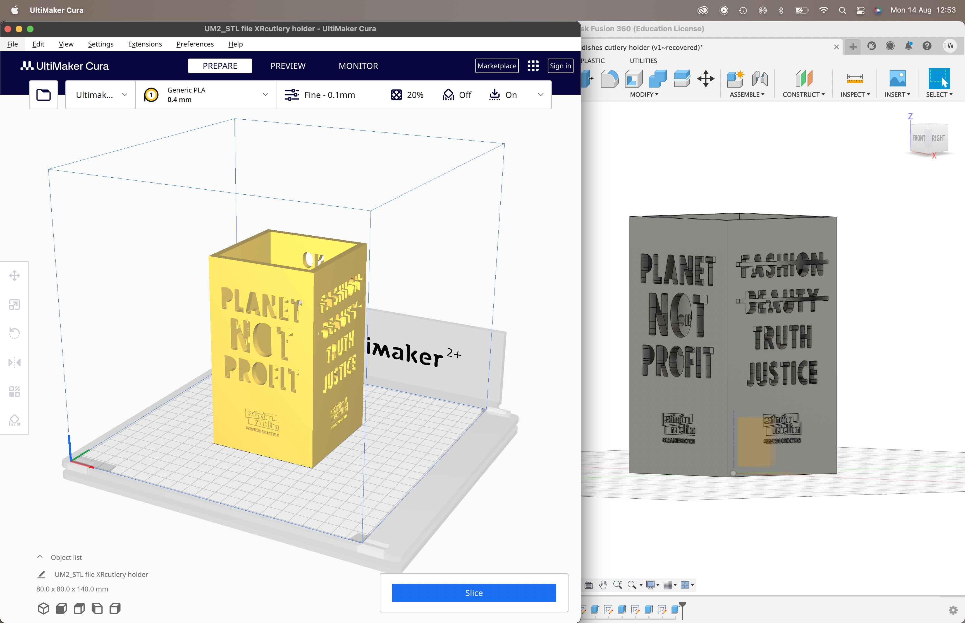
Internship
Laura Weller
AMFI 2023-2024

Slide 8
General process
Goal 2
By the end of the month September, I would like to have a clear understanding of my concept and which materials I could design for the creation of this concept. In order to achieve this, I will do research one day a week on my concept starting from August.
acclimatization phase
Research phase
Experimentation phase
Decision making phase
Understanding the company culture
Getting to know my colleagues
Understanding the machines
Understanding the way of working
Researching biomaterials
Researching Extinction Rebellion
Researching activism
Experimented with the biomaterials
Sizing,water resistance and compostable and strongness testing
Coloration of the materials
Sizing up to bigger scale
Internship
Laura Weller
AMFI 2023-2024

Slide 9
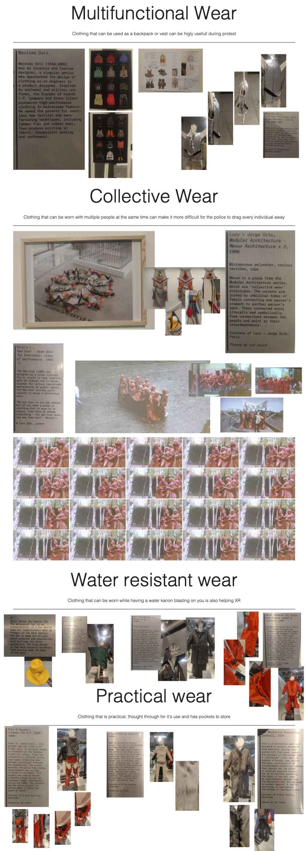
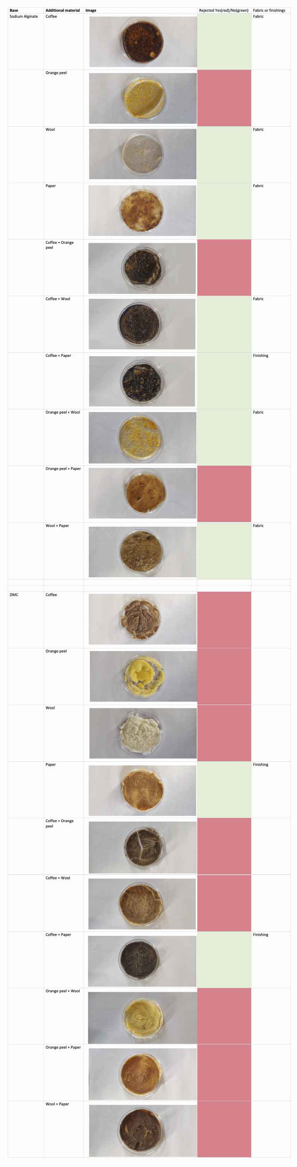

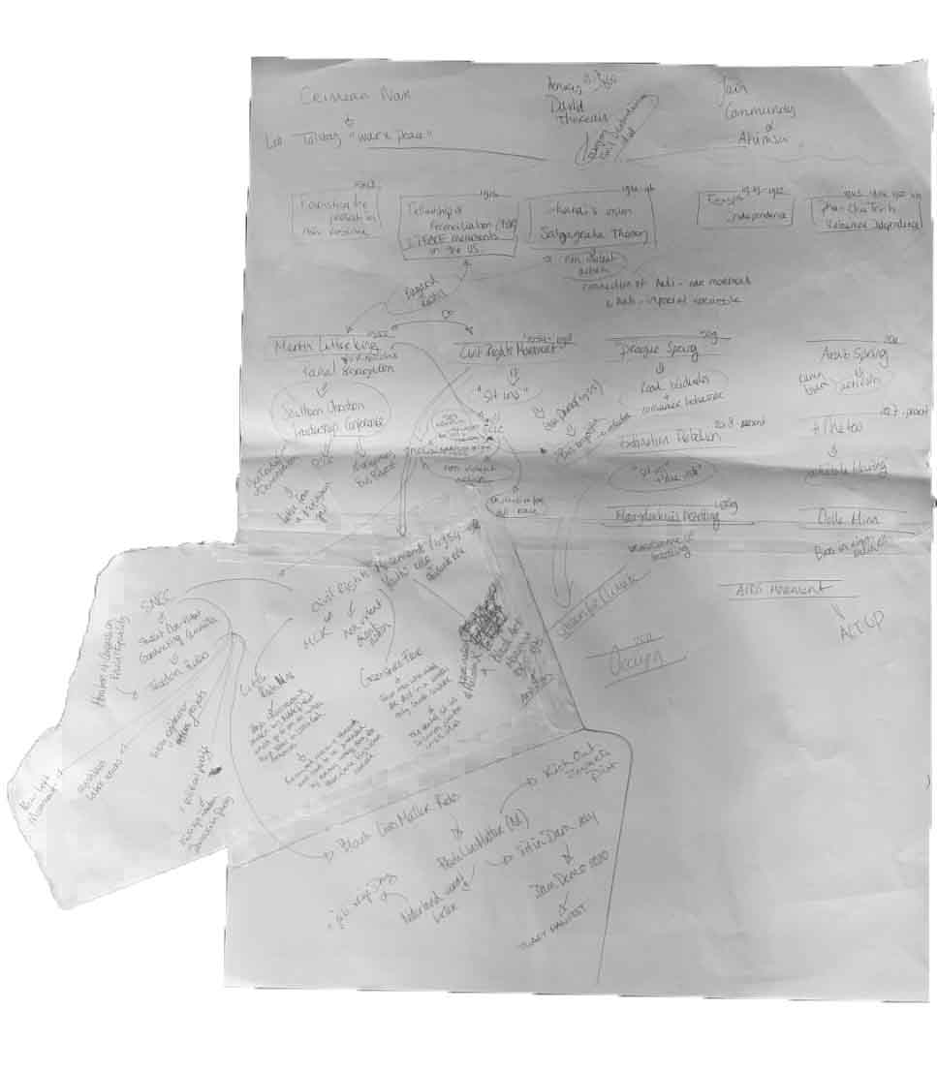
Internship
Laura Weller
AMFI 2023-2024

Slide 10
General process
Goal 4
By the end of January, I would like to have researched around 30 biomaterials and fabricated materials (or a combination of them) and have those materials digitalized in an archive. In the months November, December and January I will work 2 days a week on developing and researching these materials.
acclimatization phase
Research phase
Experimentation phase
Decision making phase
Understanding the company culture
Getting to know my colleagues
Understanding the machines
Understanding the way of working
Researching biomaterials
Researching Extinction Rebellion
Researching activism
Experimented with the biomaterials
Sizing,water resistance and compostable and strongness testing
Coloration of the materials
Sizing up to bigger scale
Internship
Laura Weller
AMFI 2023-2024

Slide 11
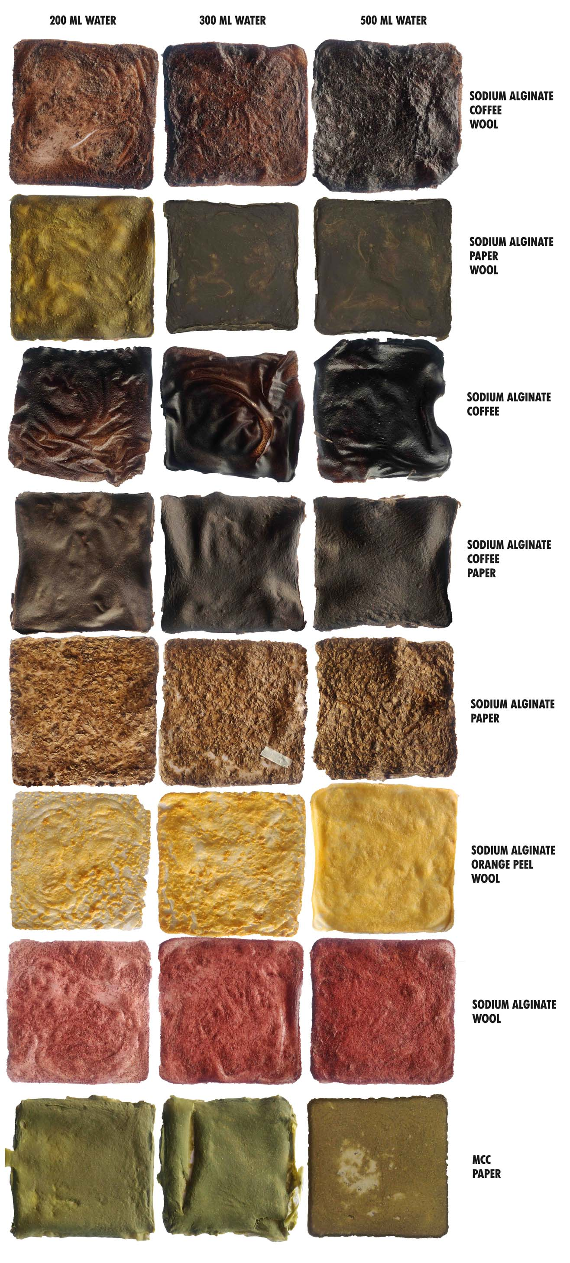
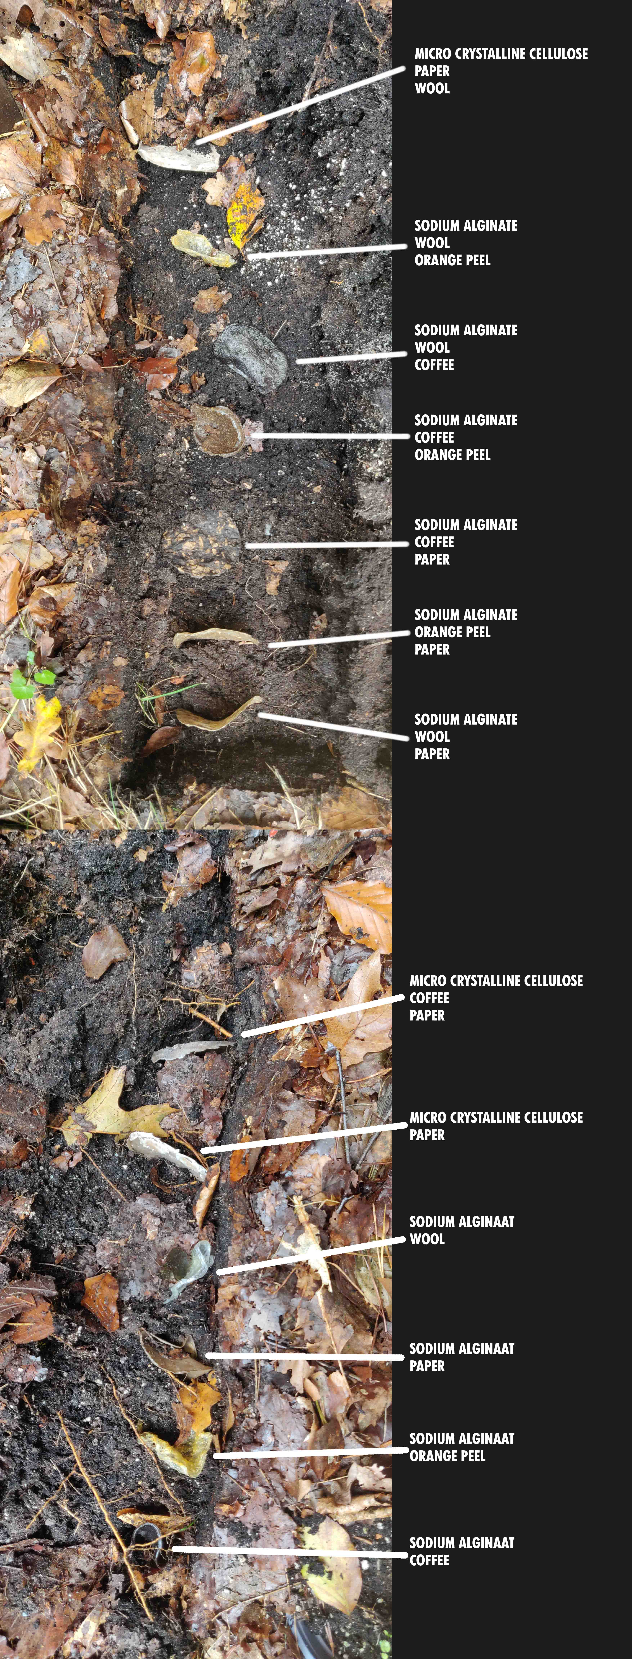
Internship
Laura Weller
AMFI 2023-2024

Slide 12
General process
Goal 4
By the end of January, I would like to have researched around 30 biomaterials and fabricated materials (or a combination of them) and have those materials digitalized in an archive. In the months November, December and January I will work 2 days a week on developing and researching these materials.
acclimatization phase
Research phase
Experimentation phase
Decision making phase
Understanding the company culture
Getting to know my colleagues
Understanding the machines
Understanding the way of working
Researching biomaterials
Researching Extinction Rebellion
Researching activism
Experimented with the biomaterials
Sizing,water resistance and compostable and strongness testing
Coloration of the materials
Sizing up to bigger scale
Internship
Laura Weller
AMFI 2023-2024

Slide 13
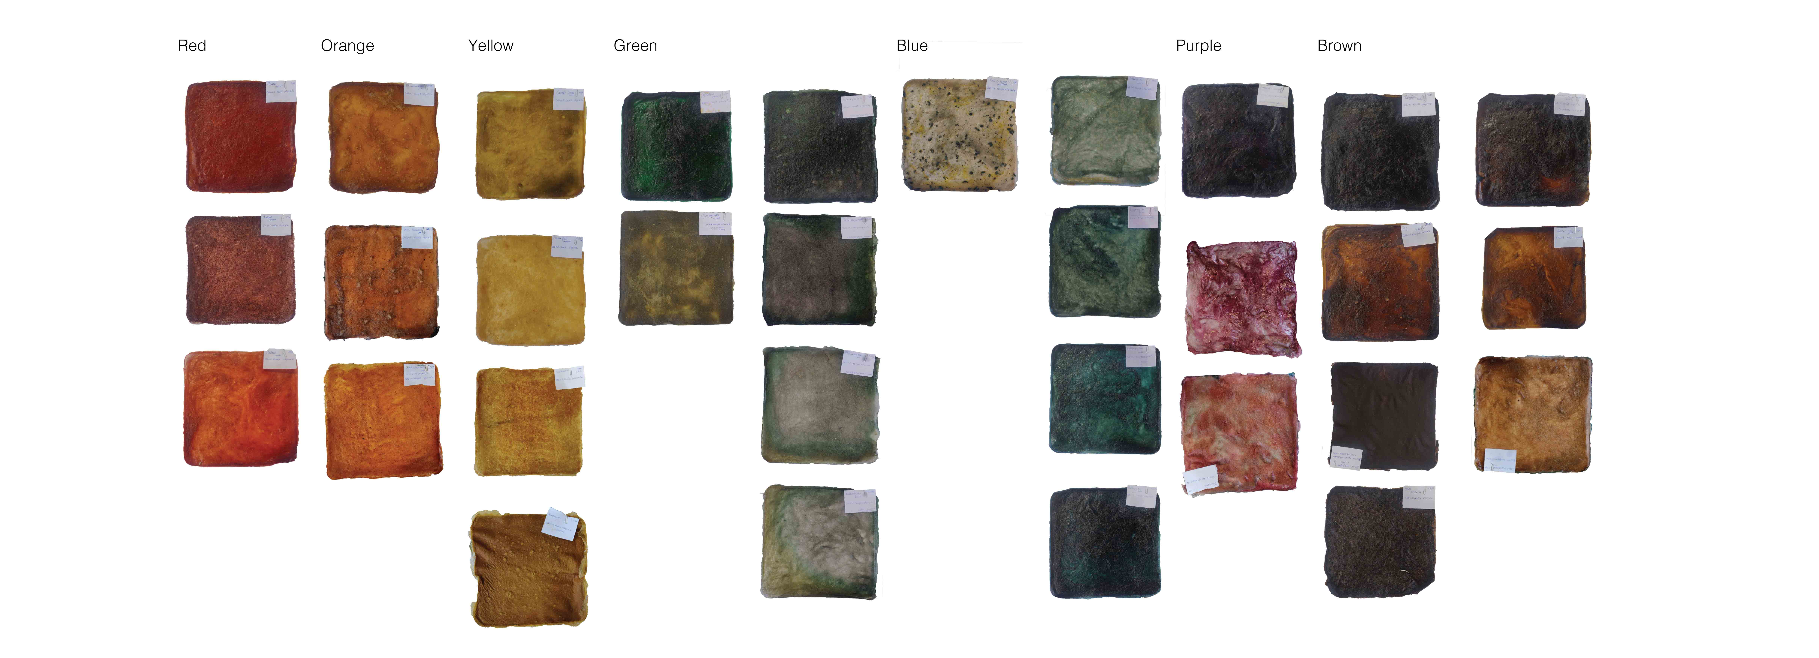
Internship
Laura Weller
AMFI 2023-2024

Slide 14
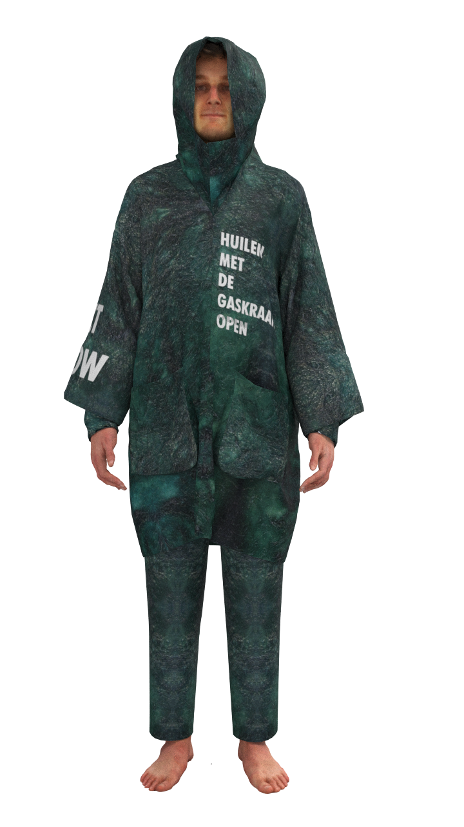
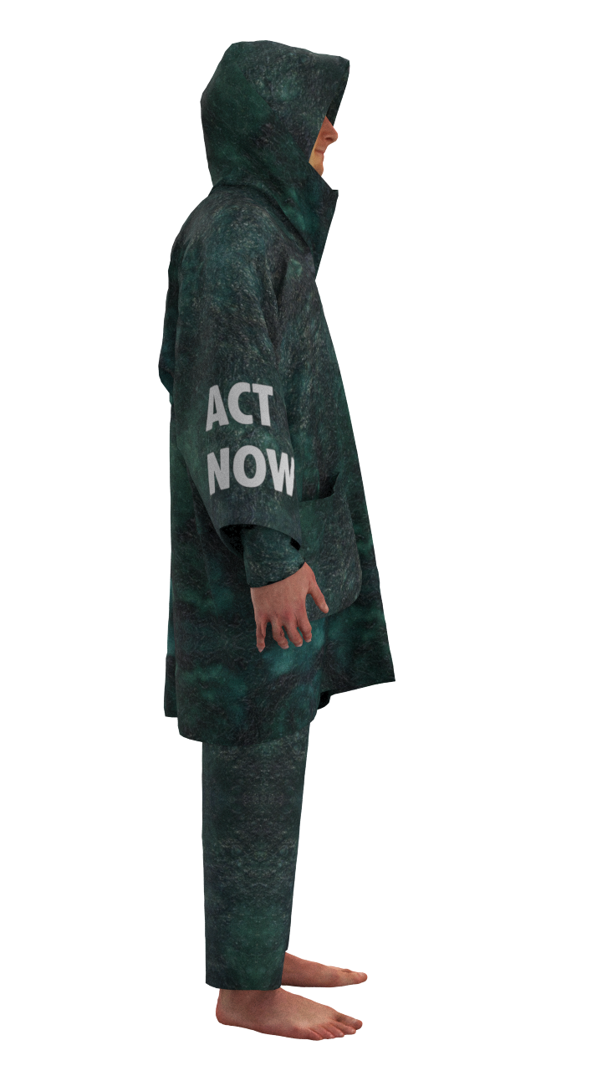
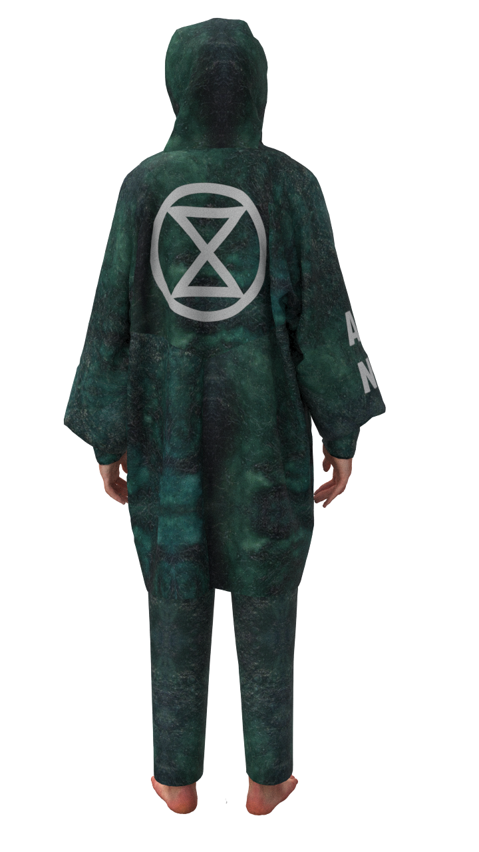
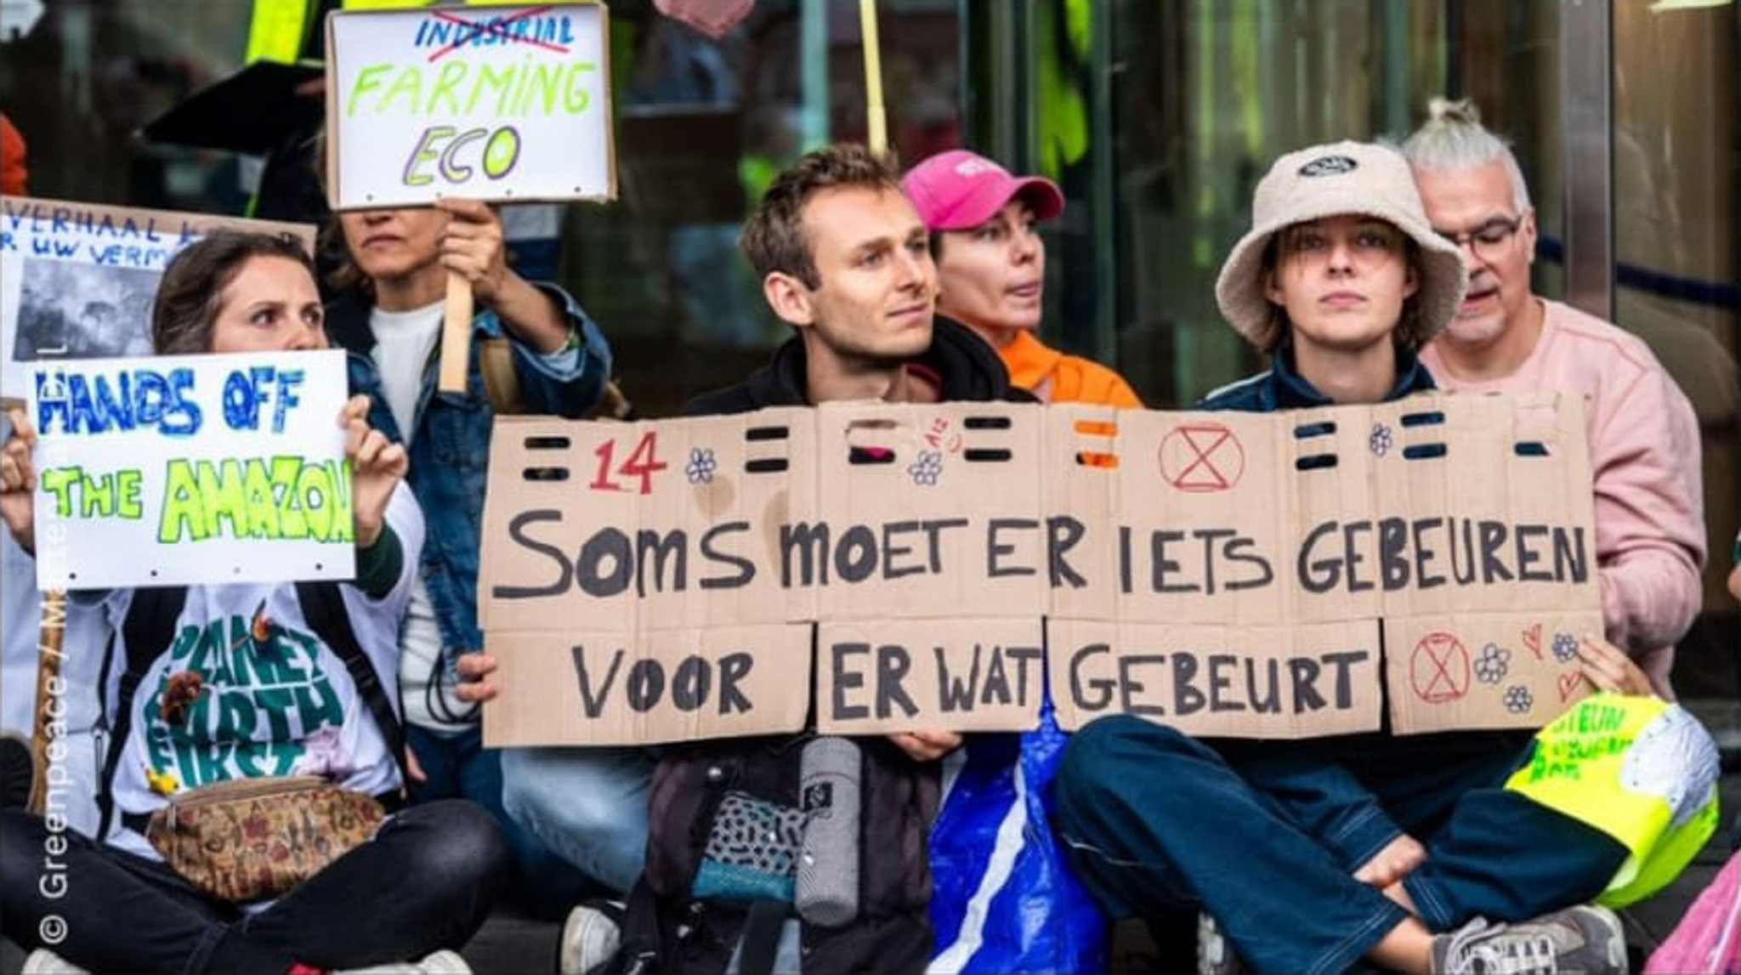
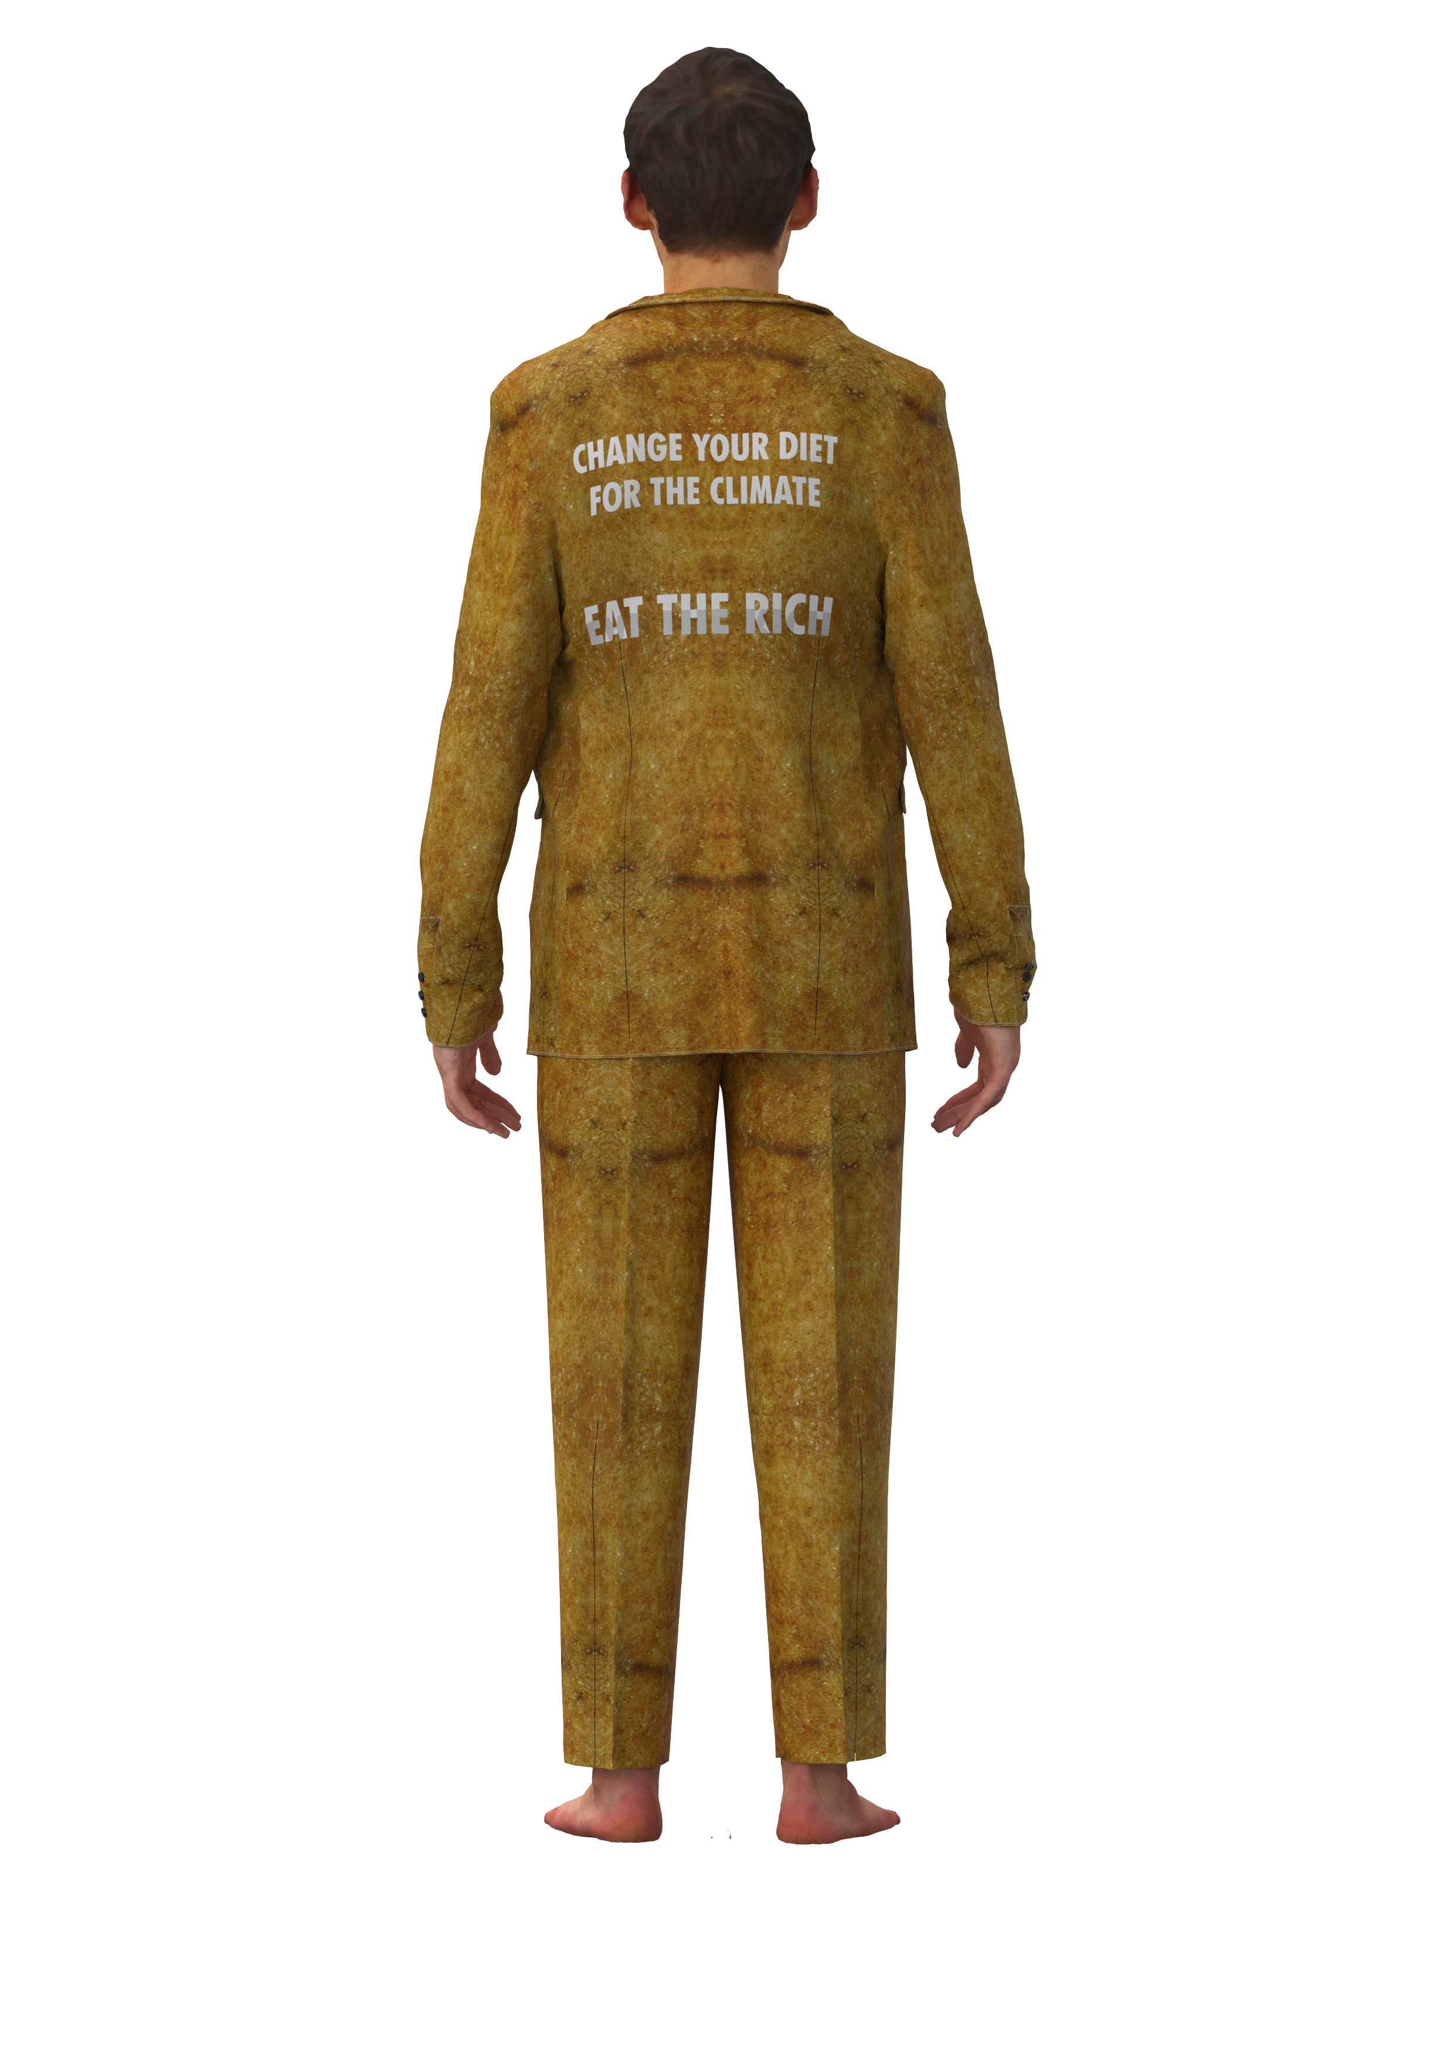
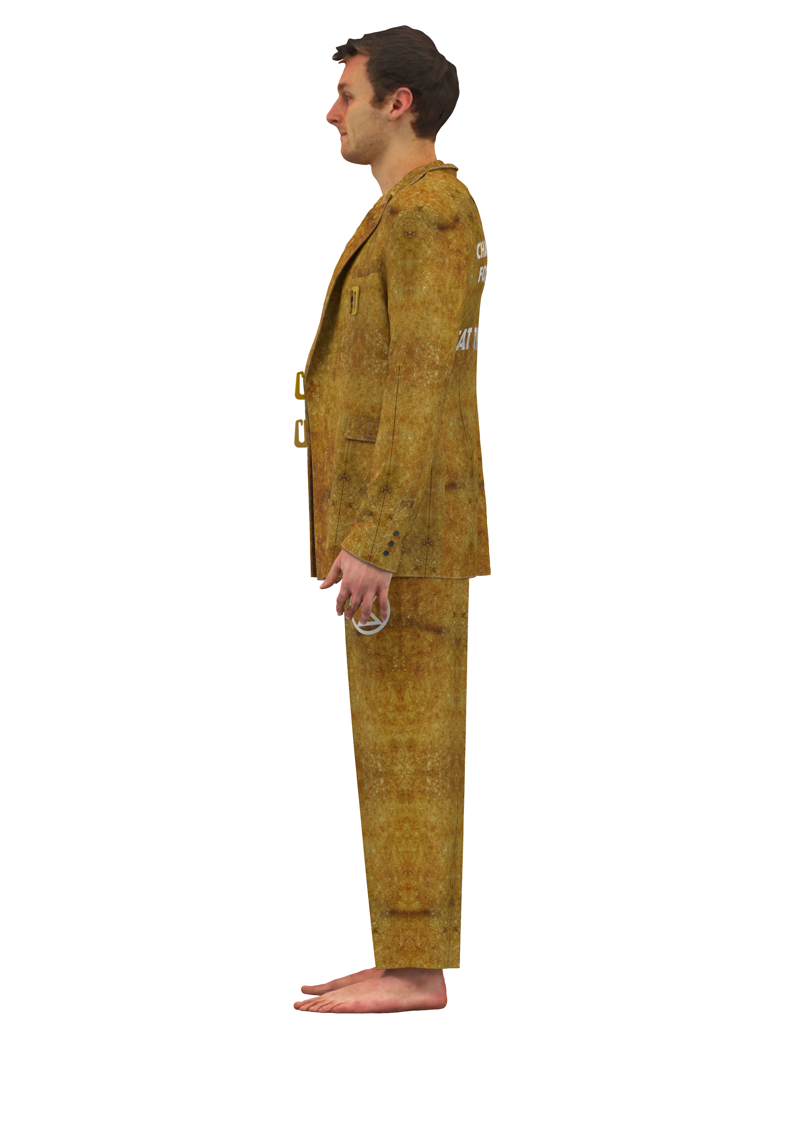
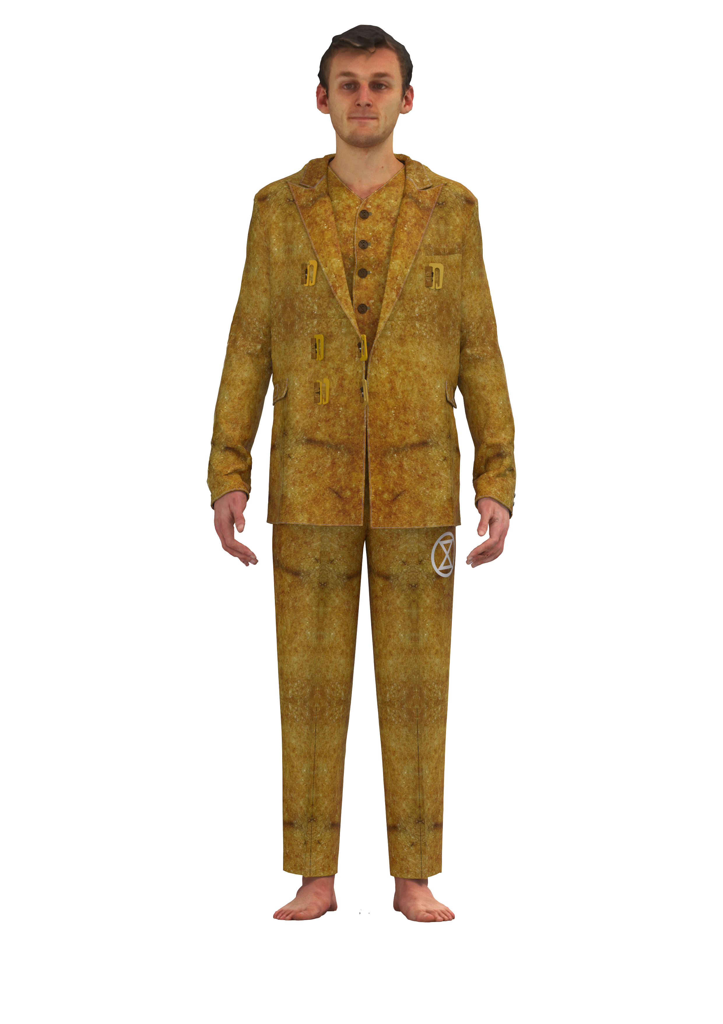
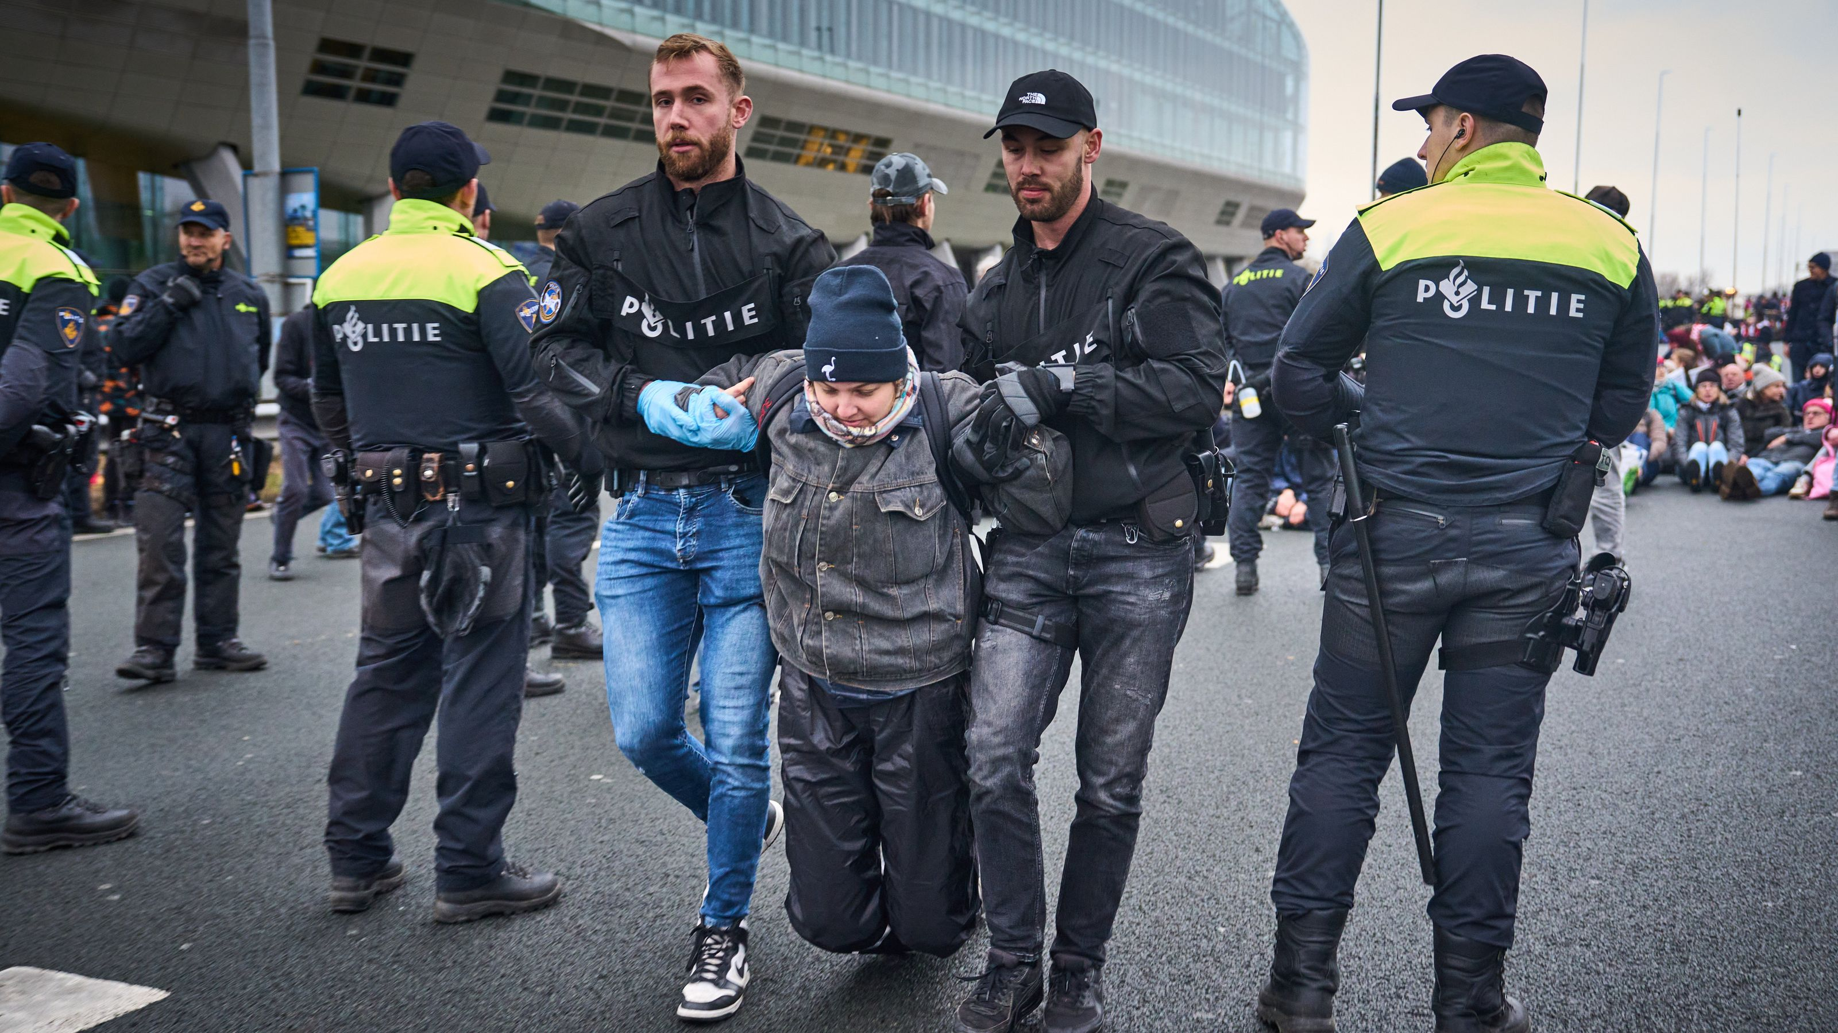
Intertwined activities
Protesting
Generating Design ideas
Github
Goal 5
By the end of January, I would like to have a full digital document (via a website) that shows my work. In order to create this, I will work half a day each week during my whole internship period to upload and visualize my process.
Internship
Laura Weller
AMFI 2023-2024

Slide 15
What about goal 3?
Goal 1
By the end of the month August, I would like to understand the way of working at De Waag. I want to understand the machines, the organizational culture and know my coworkers’ names and projects they are working on.
Goal 2
By the end of the month September, I would like to have a clear understanding of my concept and which materials I could design for the creation of this concept. In order to achieve this, I will do research one day a week on my concept starting from August.
Goal 3
By the end of October, I would like to be able to make chips to add to garments to create colors based on the heart rate of the wearer. In order to achieve this, I will work one day a week from September onwards on the chip machines and develop several chips to get an understanding of how they work.
Goal 4
By the end of January, I would like to have researched around 30 biomaterials and fabricated materials (or a combination of them) and have those materials digitalized in an archive. In the months November, December and January I will work 2 days a week on developing and researching these materials.
Goal 5
By the end of January, I would like to have a full digital document (via a website) that shows my work. In order to create this, I will work half a day each week during my whole internship period to upload and visualize my process.
Internship
Laura Weller
AMFI 2023-2024

Slide 16

future
A phygital open-source biodegradable collection that can be worn during and supports an Extinction Rebellion blockade
planning
Aug | Sept | Oct | Nov | Dec | Jan | Feb | Maart | April | Mei | Juni
Finished research paper | Finished Rebel Interviews | Finished little samples | Finished fabric recipes | Finished molds | Finished 3D samples of finishings | Finished big materials in molds | Finished design ideas (6 looks) | Finished toiles | Finished all digital designs | Finished physical look(s)
Finished website understanding for documentation | Finished research on civil disobedience | Finished understanding De Waag and machines |  | Finished color research | Finished archetypical garment study | Finished digitalising materials |  | Finished finishings for garments 3D printed | Finished line up + finished renders | Finished photoshoot and other deliverables
Internship
Laura Weller
AMFI 2023-2024

Slide 17
Questions?
Internship
Laura Weller
AMFI 2023-2024

